Slide 1


Daniya | Data Analyst Portfolio
BUSINESS INSIGHTS ON INVENTORY DATA
TURNING OPERATIONAL DATA INTO ACTIONABLE DECISIONS
Analyzed operational inventory data to identify risks and inefficiencies
Translated data into business insights for decision-making
Worked with structured datasets to support optimization strategies
November 2026

Slide 2



BUSINESS OBJECTIVE
Analyze inventory data to identify stock risks, demand concentration, and operational inefficiencies, and convert insights into actionable business recommendations.

Slide 3

PROBLEM → SOLUTION
BUSINESS PROBLEM
Stockouts affecting sales continuity
Excess inventory locking working capital
Lack of visibility into category-level performance
ANALYTICAL APPROACH
Inventory health analysis
Category-level aggregation
Reorder risk identification
Insight-driven recommendations

Slide 4
DATASET OVERVIEW
Dataset Scope
Key Variables Analyzed
Business Context
200 unique product records
Multi-category inventory data
Supplier-linked product information
Time-based inventory tracking
Stock Quantity & Reorder Level
Sales Volume
Inventory Turnover Rate
Product Status (Active, Backordered, Discontinued)
Operational inventory management
Stock availability & replenishment planning
Category-level demand assessment
Supply chain efficiency insights
Structured operational data used to evaluate inventory health, demand patterns, and optimization opportunities.

Slide 5
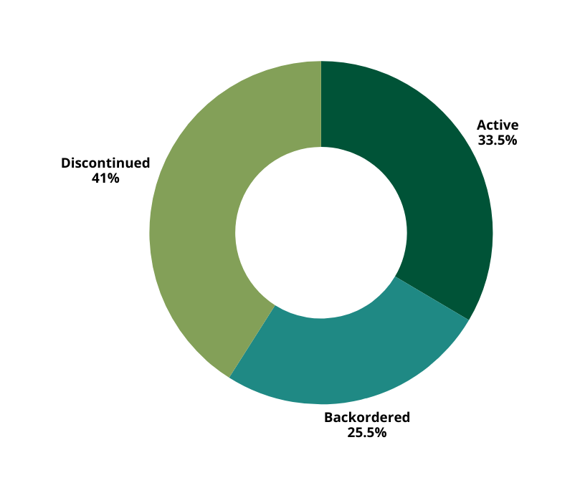
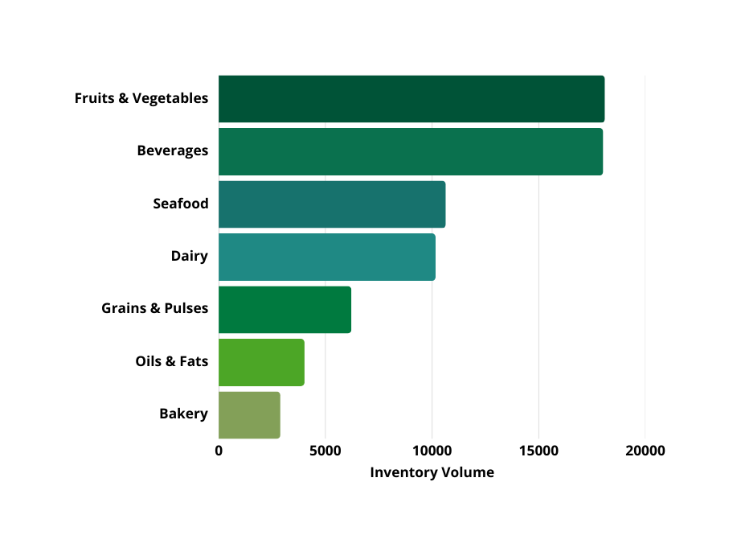
INVENTORY STATUS & CONCENTRATION
Inventory Status Snapshot
Where exactly is inventory concentrated?
Discontinued inventory dominates, exceeding both active and backordered stock while active inventory forms only about one-third, indicating limited revenue-ready inventory. Finally backordered items, while smaller in share, still represent unfulfilled demand, not excess supply.
Fruits & Vegetables and Beverages hold disproportionately higher inventory than other categories.
Categories like Bakery and Oils & Fats hold significantly lower inventory volumes.
18099
18019
10642
10165
6220
4022
2889
The key contrast here is between inventory volume and inventory usability a large share exists, but much of it is not contributing to sales.
Inventory concentration increases exposure risk problems in high-inventory categories disproportionately affect overall operations.

Slide 6
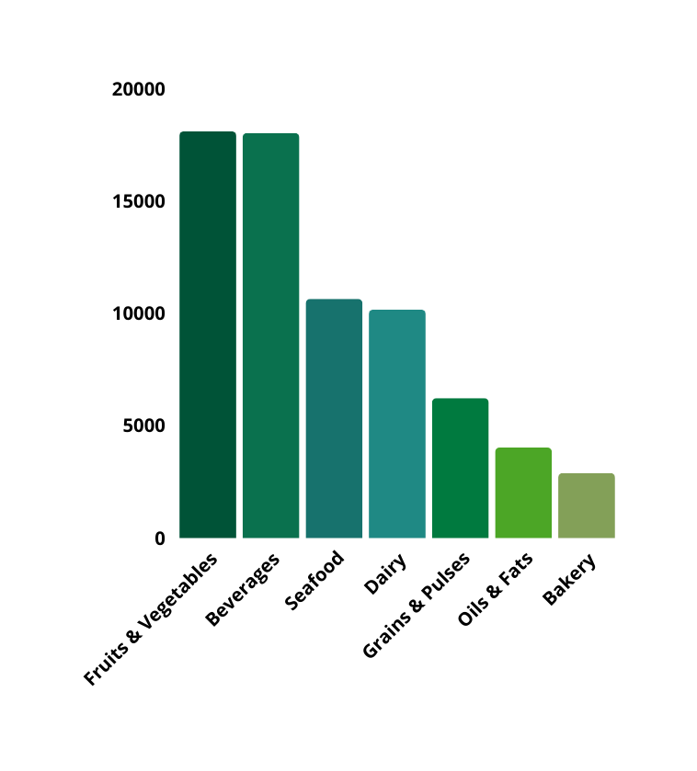
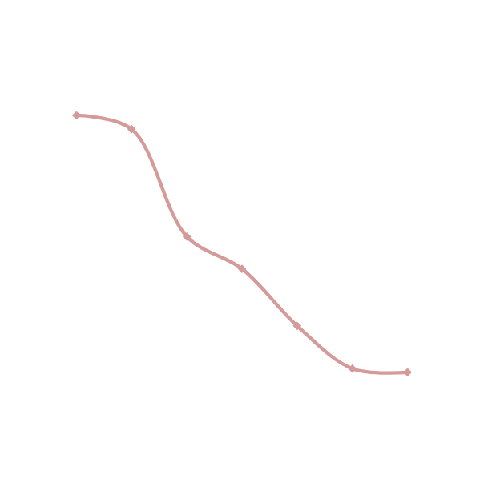
DOES HIGH INVENTORY TRANSLATE INTO STRONG SALES?
Confirms that inventory concentration ≠ operational efficiency.
SALES VS INVENTORY TURNOVER
Fruits & Vegetables generate the highest sales but show declining turnover efficiency.While some mid-inventory categories (Beverages, Dairy) have lower sales relative to stock held. Low-inventory categories also show lower sales but more proportional turnover.
18099
18019
10642
10165
6220
4022
2889
The key contrast is between revenue generation and efficiency:
High sales do not automatically imply efficient inventory usage.

Slide 7
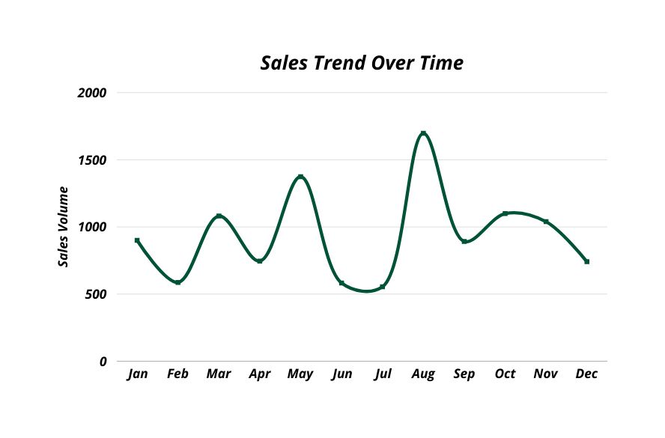
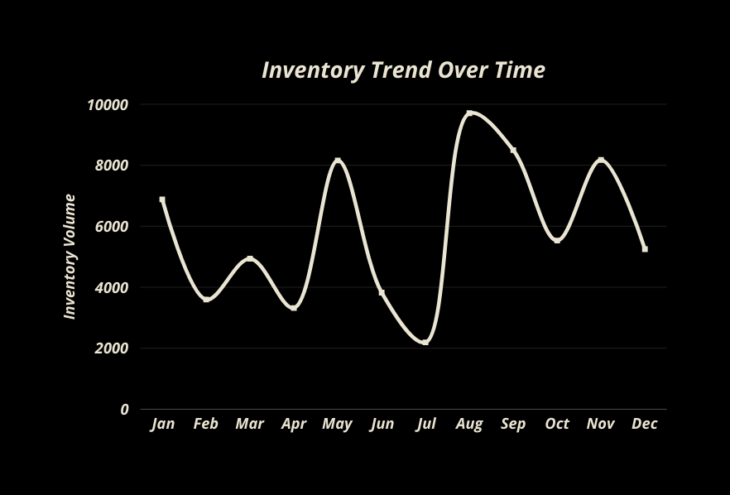
HOW DO INVENTORY AND SALES BEHAVE OVER TIME?
Parallel time-series trends for inventory levels and sales volume across months.
Inventory levels fluctuate sharply, while sales follow smoother, lagged patterns.
Peaks in inventory often precede sales increases, suggesting over-buffering.
In some periods, inventory rises without a corresponding sales lift. Inventory planning appears reactive rather than demand-aligned, increasing holding costs and risk of obsolescence.
Time misalignment introduces profit risk, explored next.

Slide 8

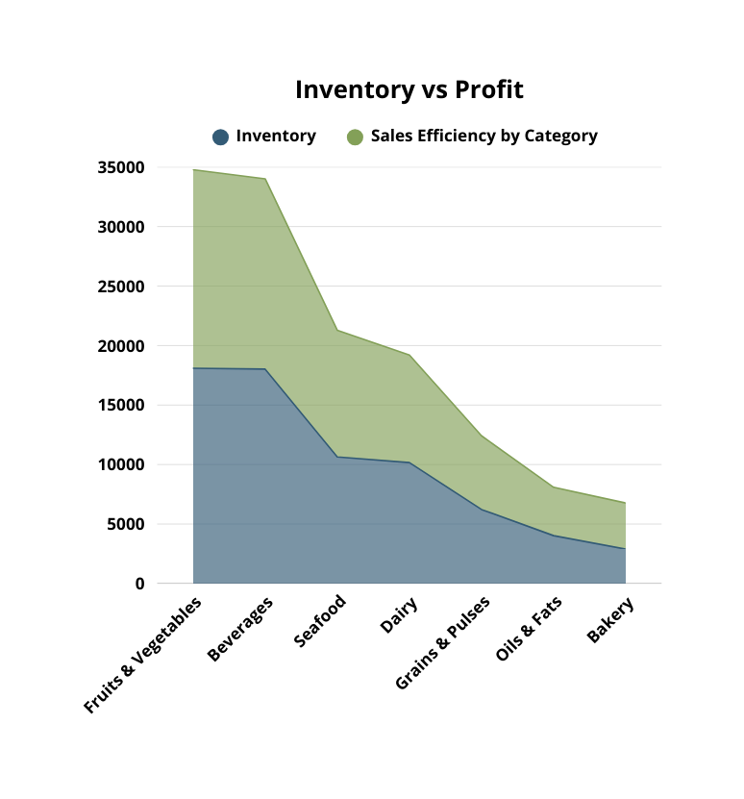
RISK ANALYSIS
Some high-inventory categories contribute disproportionately lower profit. Lower-inventory categories sometimes show better profit efficiency. Inventory accumulation does not scale linearly with profitability.
This highlights capital misallocation risk, excess stock does not guarantee financial return.

Slide 9
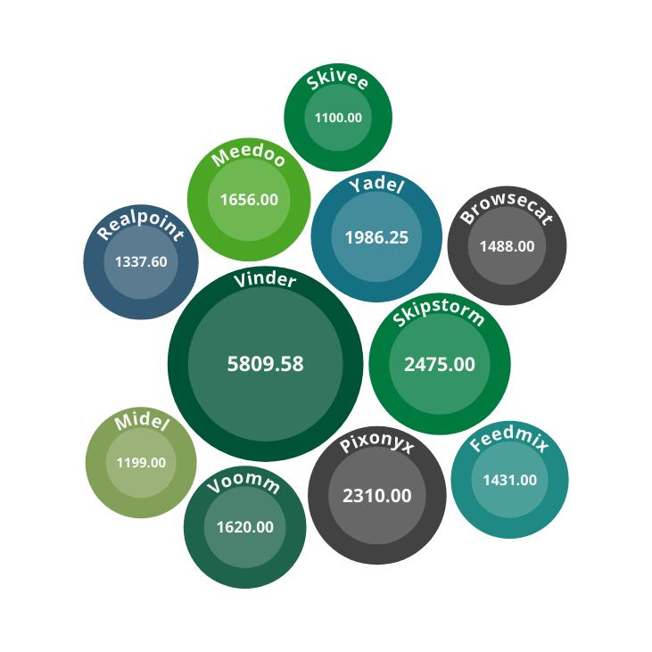
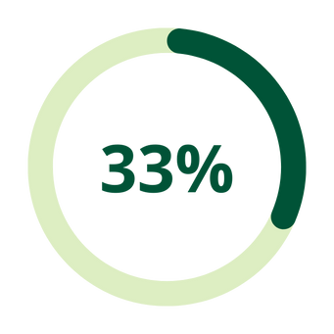
DOES SUPPLIER CONCENTRATION EXPOSE US TO REVENUE RISK?
Diversifying supplier revenue could reduce disruption exposure without impacting sales
Supplier Concentration Risk
33% of total sales depend on a single supplier (Vinder)
Top 3 suppliers contribute ~60–65% of total sales
Multiple suppliers hold inventory but generate minimal revenue
Vinder
Over 30% revenue dependence on a single supplier exposes the business to critical operational and financial risk.
Industry safe threshold: < 20%
Current exposure: High risk

Slide 10

SALES & PROFITABILITY
01
Total Sales Revenue
02
Total Profit
₹ 66,518
₹ 3,538.0
03
Profit Margin %
04
Revenue Per SKU
5.32%
₹ 332.59

Slide 11
INVENTORY EFFICIENCY & SUPPLIER RISK
01
Average Inventory per SKU
02
Slow-Moving SKU Count
350
91
03
Supplier Concentration Risk
04
Single-Source Dependency %
33%
1.50%

Slide 12
INVENTORY HEALTH
01
Total SKUs
02
Active SKUs
200
67
03
Non-Active Inventory %
04
Stockout Risk Count
66%
133

Slide 13
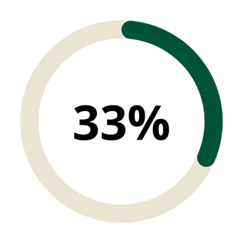
KEY TAKEAWAYS
66% | Inventory is non-active (backordered or discontinued), indicating excess stock and demand mismatch.
60% | Top inventory categories account for total stock, increasing concentration risk.
Supplier Concentration Risk
A high proportion of inventory is non-active or slow-moving, increasing holding costs.
Inventory levels are not aligned with sales and profit, indicating inefficient stock allocation.
A small number of suppliers contribute a disproportionately large share of total sales, increasing supply chain risk.
Profitability is uneven across products despite similar inventory levels.
Vinder
Industry safe threshold: < 20%
Current exposure: High risk

Slide 14
THANK YOU
Portfolio
Github
Linkedin

